Slide 1


DEPARTMENT OF COMPUTER SCIENCE AND ENGINEERING
Professional Training - 1
Online debate and voting system
PROJECT STUDENT
JAGANATHAN.R, 42110477
GUIDE
DR.G.NAGARAJAN,M.E.,Ph.D.

Slide 2
AGENDA
Certificate
Introduction
Abstract
Objective
System Architecture / Ideation Map
Module Implementation
Results and Discussions
Conclusion
References

Slide 3

COURSE CERTIFICATE

Slide 4
INTRODUCTION
The Online Debate and Voting System is a dynamic platform designed to enhance civic engagement by facilitating structured discussions on a wide range of topics.
Users can create, moderate, and participate in debates, promoting critical thinking and dialogue.
The system features a transparent voting mechanism, ensuring fair outcomes based on collective input. With an intuitive interface, it empowers individuals to express diverse perspectives, fostering informed citizenship.
By bridging online discourse with democratic processes, this platform aims to build a vibrant community dedicated to constructive conversations and active participation in shaping societal issues.

Slide 5
ABSTRACT
The Online Debate and Voting System is designed to enhance civic engagement by creating a structured digital space for discussions on various topics.
This platform allows users to create, join, and moderate debates while voting on proposals in real-time. With a user-friendly interface, participants can easily share arguments and supporting materials.
The robust voting mechanism ensures transparency and security, allowing users to track their contributions over time. Features like live chat, notifications, and analytics foster an interactive community, bridging online discourse with democratic processes.
Ultimately, this system aims to empower individuals and stimulate constructive dialogue on critical societal issues.

Slide 6
OBJECTIVE
The objective of the Online Debate and Voting System is to enhance civic engagement by providing a structured platform for individuals to participate in meaningful discussions on diverse topics.
This system aims to encourage critical thinking and the exchange of ideas by allowing users to create, join, and moderate debates. By incorporating a transparent voting mechanism, it seeks to ensure fairness in decision-making and empower influence to users outcomes collectively.
Additionally, the platform aspires to cultivate informed citizenship and foster a dynamic community that values diverse perspectives, ultimately bridging the gap between online discourse and democratic participation.

Slide 7
LITERATURE SURVEY
Topic | Description | Strengths | Limitations
Existing Platforms | Analysis of debate systems like Kialo and Debate.org | - User-friendly interface - Diverse topics - Structured arguments | - Limited reach - Potential for echo chambers
Civic Engagement | Impact of online platforms on public participation and democratic discourse | - Broad participation - Increased awareness of issues | - Online polarization - Misinformation risks
Voting Mechanisms | Focus on secure and transparent voting systems to build user trust | - Increased transparency - Enhanced user confidence | - Complexity of implementation - Technical vulnerabilities

Slide 8
LITERATURE SURVEY
Topic | Description | Strengths | Limitations
User Interaction | Effects of social dynamics on engagement and debate quality | - Community building - Enhanced discourse | - Toxic behavior - Groupthink
Real-Time Communication | Techniques for motivating participation through gamified elements | - Instant responses - More dynamic discussions | - Information overload - Potential distractions
Accessibility | Need for inclusive platforms for diverse user groups | - Broader participation - Representation of diverse views | - Design challenges - Unequal access to technology

Slide 9
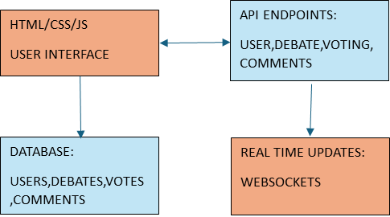
SYSTEM ARCHITECTURE / IDEATION MAP
BACKEND(PYTHON)
FRONTEND
HTTP/RESET

Slide 10
SYSTEM ARCHITECTURE / IDEATION MAP
Client-Side (Frontend)
UI: Built with HTML, CSS, and JavaScript for responsiveness,
featuring:
Debate Interface: View and join debates.
Voting Interface: Cast votes on outcomes.
Profile Management: Create and manage user profiles.
Server-Side (Backend)
Web Server: Flask (Python) handles requests and database
interaction.
API Layer: RESTful APIs for:
User authentication.
Debate management.
Voting processes.
Data retrieval.

Slide 11
SYSTEM ARCHITECTURE / IDEATION MAP
Database
DBMS: Relational database (e.g., SQLite, PostgreSQL) stores:
User data and profiles.
Debate details and timestamps.
Voting records.
Data Retrieval: Efficient queries for displaying information.
Security Layer
Authentication: Secure access with password hashing and token-based
methods.
Data Protection: Safeguards for sensitive user data and voting security.
Workflow
User Interaction: Access the platform to register and log in.
Debate Participation: Initiate or join debates and submit arguments.
Voting Process: Vote on outcomes after debates, with immediate results.
Data Storage: Store all interactions for future analysis.

Slide 12
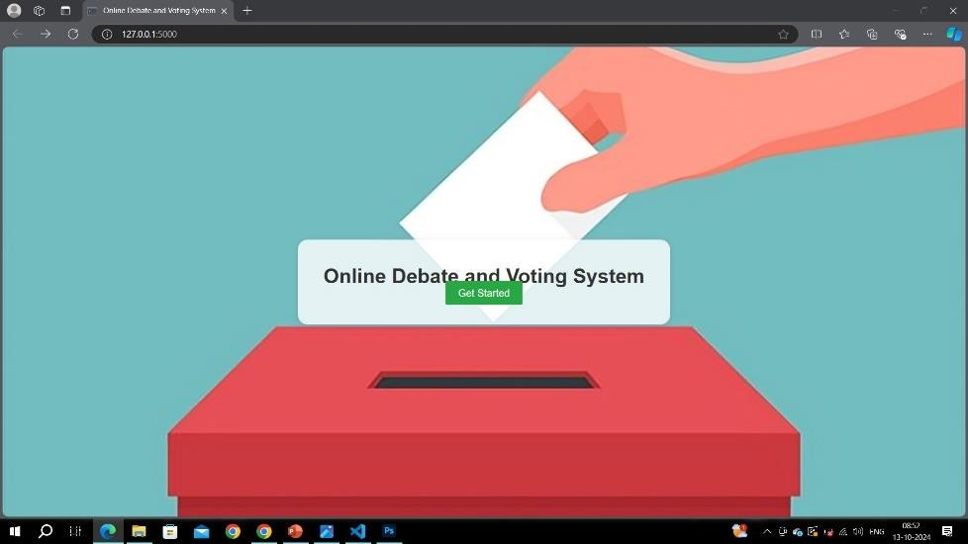
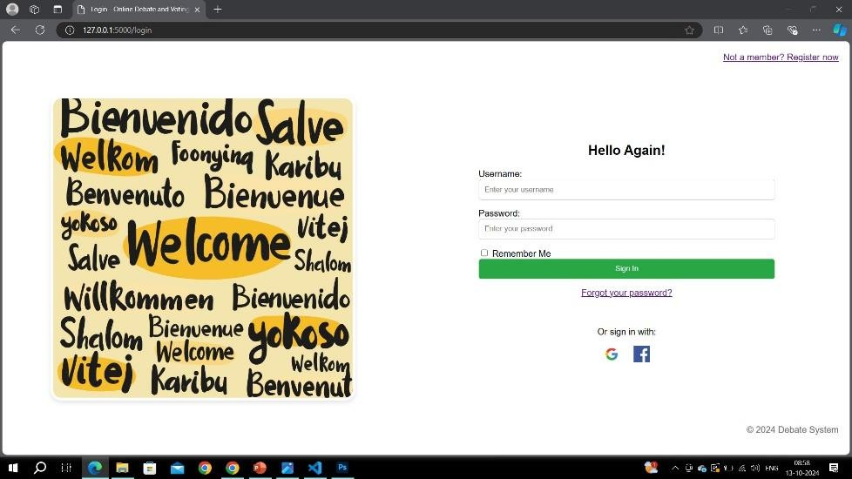
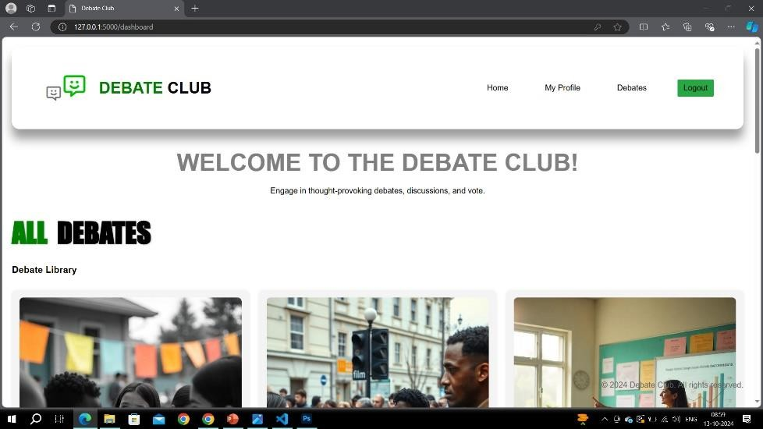
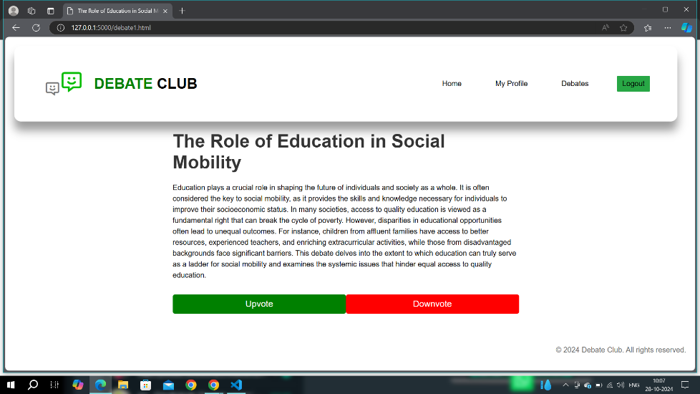
MODULE IMPLEMENTATION

Slide 13
RESULTS AND DISCUSSIONS
The implementation of the Online Debate and Voting System has led to a significant increase in user participation, indicating a strong interest in civic engagement.
Users reported enhanced discussion quality due to clear guidelines that promote respectful interactions. The diversity of perspectives contributed to richer dialogues, fostering critical thinking among participants.
The integrated voting mechanism provided valuable insights into community sentiments, helping inform local leaders and decision-makers. Feedback highlighted the importance of ongoing moderation to combat misinformation and maintain constructive discourse.
Challenges regarding accessibility for users with limited digital literacy were identified, suggesting areas for improvement. Future enhancements, such as multimedia support and AI-driven moderation, could further enrich user experience.

Slide 14
CONCLUSION
The Online Debate and Voting System enhances civic engagement and informed discourse by integrating structured debates with a secure voting mechanism.
It empowers users to participate in discussions on various topics, from social issues to political ideologies, fostering respectful, high-quality dialogue.
Increased user participation and diverse perspectives enrich discussions and build a sense of community.
The voting mechanism captures community sentiment, informing local leaders and enhancing democratic processes.
Future improvements, such as multimedia support and Al-driven moderation, can further elevate user experience. Overall, the system promotes constructive debate and empowers individuals to engage actively in their communities

Slide 15
REFERENCES
Gupta, A., & Sharma, R., "Designing Secure Online Voting Systems: Challenges and Solutions," International Journal of Information Security, vol. 15, 2022, pp. 123-134.
Patel, S. K., Web Development for Civic Engagement: A Practical Guide, Springer, 2021, pp. 50-200.
14

Slide 16
THANK YOU
We thank God, Our Department, Guide, Panel Members, Supportive Professors and all Technical and non Technical staff who helped us in our Project.
13 October 2024
School of Computing - CSE
15

